Slide 1
Battle of the Neighborhoods
New York City VS Los Angeles
Ronald Chen
IBM Data Science

Slide 2


Slide 3
Introduction
Financial investment opportunity and want to invest in a property where you can rent it out to tenants and act as a passive income.
Location: New York City or Los Angeles
Residential property income
The vast majority of residential property income comes in the form of basic rent. Your tenants pay a fixed amount per month, which will go up with inflation and demand and you take out your costs from it, claiming the remaining portion as rental income. A desirable location is critically important to ensure that you can secure tenants easily.
Commercial property income
Commercial properties can produce income from the aforementioned sources, with basic rent again being the most common, but can also add one more in the form of option income. Many commercial tenants will pay fees for contractual options like the right of first refusal on the office next door. Tenants pay a premium to hold these options whether they exercise them or not. Options income sometimes exists for raw land and even residential property, but they are not common.

Slide 4
Business Problem - investment opportunity
Investment opportunity for buying a house in the USA at the capital cities of the East or West coast. The cities are New York City or Los Angeles. Renting out places to tenants is a popular term and hype. They use platforms like Airbnb to get tenants.
Location is one of the main conditions where you can determine the renting price where possible leads and able to generate a high income. There are several ways you can earn income from residential properties. Below here you can find some examples.

Slide 5
Business Problem
Buy and hold
This is one of the more traditional ways of earning income from real estate. There are a number of ways to accomplish this: You can buy a single-family home and rent it out; buy a multi-family home and live in one of the units while renting the others; ideally to cover the mortgage and your own housing expenses; or purchase a multi-family home and rent all of the units; either managing the property yourself or hiring a management company to handle renting units, collecting rent, addressing needed repairs, and so on.
Flipping
Property flippers specialize in adding high-return fixes to houses in a short time and then selling them. Flipping can be lucrative if you know how to find properties to fix up, you have the necessary skills to do the renovations yourself or oversee a crew to carry them out, and you have a sense of a property's underlying costs and potential value.

Slide 6
Business Problem
Airbnb and vacation rentals
Although the COVID-19 pandemic has put the brakes on it for now, the demand for home-away-from-home rentals had taken off in recent years as many travelers preferred this option to staying in a hotel. Homeowners could earn income by renting out a house or even just a room on a short-term basis, especially if the property is in an area that's a well-known tourist destination. It's unclear when that market will return. But should it reappear, keep in mind that short-term rentals are regulated and sometimes even banned in certain cities. Check your city's bylaws before listing a property on a website such as Airbnb, VRBO, or HomeAway. And also figure in what additional deep cleaning and sanitizing between guests will add to the costs.

Slide 7
Business Problem - End result
In this report the research will be focussed on the way of renting out the property. It could be vacation rentals or lease options. So which city has the potential to generate the highest income and will be determined where the property will be invested. The decision is based on several factors, being able to rent out is based on a short stay or a long stay. With short stay you consider a time period of 30 days or less and above will consider long stay. The tenants will be the people for sightseeing (tourists), business trips or looking for a temporary stay.
The analysis will be conducted based on data sources and by using several data science tools the optimum results will be delivered.

Slide 8
Methodology
To determine the wealth and income disparity, the realty values and the tourism-- there is going to be the use of exploratory data analysis, data visualization tools, model development and evaluation.
The property investment can lead to two different property income;

Slide 9
Methodology
Residential property income
The vast majority of residential property income comes in the form of basic rent. Your tenants pay a fixed amount per month—which will go up with inflation and demand—and you take out your costs from it, claiming the remaining portion as rental income. A desirable location is critically important to ensure that you can secure tenants easily.
Commercial property income
Commercial properties can produce income from the aforementioned sources, with basic rent again being the most common, but can also add one more in the form of option income. Many commercial tenants will pay fees for contractual options like the right of first refusal on the office next door. Tenants pay a premium to hold these options whether they exercise them or not. Options income sometimes exists for raw land and even residential property, but they are not common.
To find out the most optimal profit, the two places; New York City and Los Angeles, will be researched on how high is the value of the realties, the wealth and income disparity, and the amount of tourists visiting the two places

Slide 10
Methodology
The wealth and income disparity
In which city has the greatest amount of income. What kind of income and sector are they working in? It is important to look at it, it will increase the certainty that tenants will be able to afford the rental property and reduce the risks of not paying.
Tourism ( the amount of visitors )
For people who are staying a short time are mostly tourists. For seeing the sights and enjoying the activities and attractions that the place has to offer. More tourists means the possibility to increase your renting price. Depending on the tourism and a populair location you will be able to get higher rates due the high demand.
Location
The location is essential, it drives the people which places they want to visit or live. The place needs to offer the requirements to meet up the expectations. What kind of sights; tours, activities, attractions. Like catering establishments for social activities and other local hotspots. Allow you to see how safe the area feels and how well-presented the nearby streets and other buildings are. Living in an area with a sense of community and pride can provide peace-of-mind and ensure long-standing happiness. Where you live can have a massive impact on your personal health and happiness, because it’s not just the interiors of an apartment that matter, it’s also the community surrounding your new home.

Slide 11
Data Analysis Results
New York City VS Los Angeles

Slide 12
Data Analysis
By conducting visualization analysis from different data resources, the results of the two cities will be determined. We are going to learn from the results and decide which city is most suitable for an investment.

Slide 13
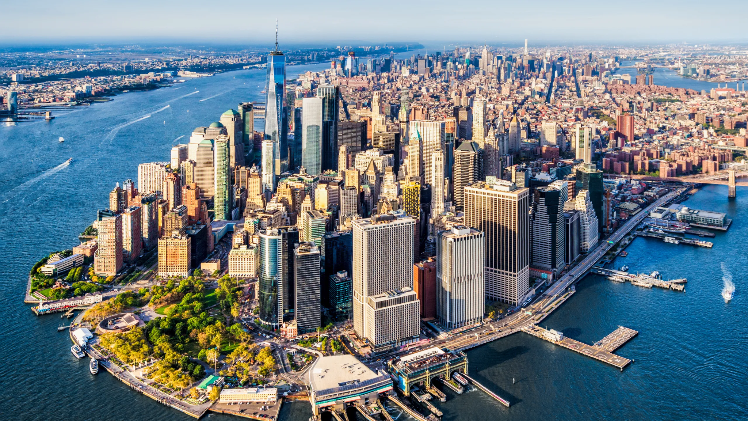
New York City
New York City (NYC), often simply called New York, is the most populous city in the United States. With an estimated 2019 population of 8,336,817 distributed over about 302.6 square miles (784 km2), New York City is also the most densely populated major city in the United States. Located at the southern tip of the State of New York, the city is the center of the New York metropolitan area, the largest metropolitan area in the world by urban landmass. With almost 20 million people in its metropolitan statistical area and approximately 23 million in its combined statistical area, it is one of the world's most populous megacities. New York City has been described as the cultural, financial, and media capital of the world, significantly influencing commerce, entertainment, research, technology, education, politics, tourism, art, fashion, and sports, and is the most photographed city in the world. Home to the headquarters of the United Nations, New York is an important center for international diplomacy, and has sometimes been called the capital of the world.

Slide 14
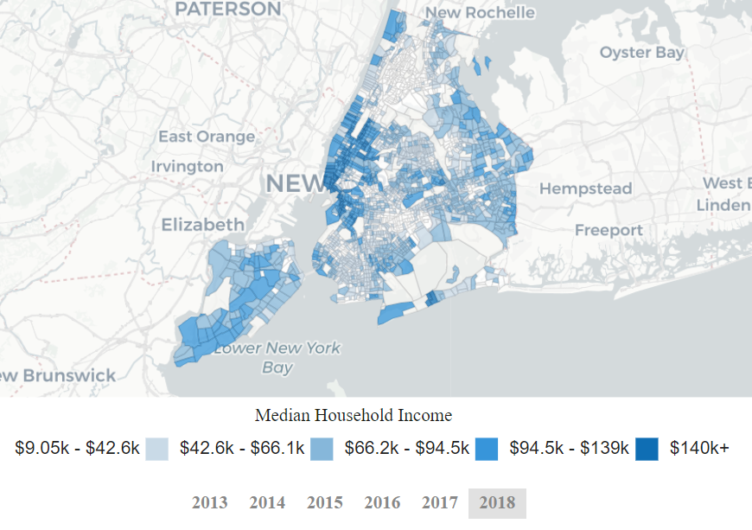
Wealth and Income disparity
New York City, like other large cities, has a high degree of income disparity. In the first quarter of 2014, the average weekly wage in New York County (Manhattan) was $2,749, representing the highest total among large counties in the United States. As of 2017, New York City was home to the highest number of billionaires of any city in the world at 103.
New York also had the highest density of millionaires per capita among major U.S. cities in 2014, at 4.6% of residents. New York City is one of the relatively few American cities levying an income tax (about 3%) on its residents.As of 2018, there were 78,676 homeless people in
New York City

Slide 15
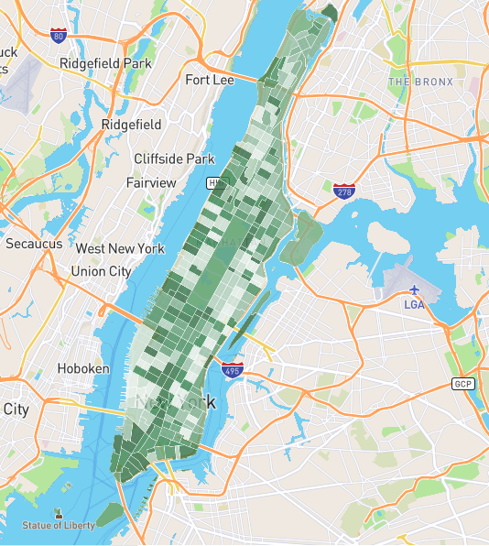
Real Estate - property value
With a population of 1,628,706, 759,460 total housing units (homes and apartments), and a median house value of $1,167,748, New York house prices are not only among the most expensive in New York, New York real estate also is some of the most expensive in all of America. Large apartment complexes or high rise apartments are the single most common housing type in New York, accounting for 94.90% of the borough's housing units. Appreciation rates for homes in New York have been tracking above average for the last ten years, at least according to NeighborhoodScout data. The cumulative appreciation rate over the ten years has been 46.67%, which ranks in the top 30% nationwide. This equates to an annual average New York house appreciation rate of 3.90%. In New York you can see the average rental prices. The prices varietes from a minimum of $2000 - $6000 per month.

Slide 16
Tourism -
visitors
Year | Total Visitors (millions) | Domestic Visitors | International Visitors | Total Visitor Spending Billions(US$)
2014 | 54.4 | 42.5 | 11.9 | 41.2
2015 | 55.9 | 43.2 | 12.7 | 42.3
2016 | 60.5 | 47.8 | 12.7 | 43.0
2017 | 62.8 | 49.7 | 13.1 | 43.5
2018 | 65.2 | 51.6 | 13.5 | 44.0
Tourism is a vital industry for New York City, which has witnessed a growing combined volume of international and domestic tourists, receiving an eighth consecutive annual record of approximately 65.2 million visitors in 2018. Tourism had generated an all-time high $61.3 billion in overall economic impact for New York City in 2014, pending 2015 statistics. Approximately 12 million visitors to New York City were from outside the United States, with the highest numbers from the United Kingdom, Canada, Brazil, and China.
According to U.S. government resources, every year the total visitors is only increasing and the spending of the visitors is increasing as well.

Slide 17

Los Angeles
Los Angeles, officially the City of Los Angeles and often abbreviated as L.A., is the largest city in California. It has an estimated population of nearly 4 million and is the second-largest city in the United States, after New York City, and the third-largest city in North America, after Mexico City and New York City. Los Angeles is known for its Mediterranean climate, ethnic and cultural diversity, Hollywood entertainment industry, and its sprawling metropolitan area.
Los Angeles lies in a basin in Southern California, adjacent to the Pacific Ocean, with mountains as high as 10,000 feet (3,000 m), and deserts. The city, which covers about 469 square miles (1,210 km2), is the seat of Los Angeles County, the most populous county in the United States. The Los Angeles metropolitan area (MSA) is home to a population of 13.1 million, making it the second-largest metropolitan area in the nation after that of New York.Greater Los Angeles includes metro Los Angeles as well as the Inland Empire and Ventura County.

Slide 18
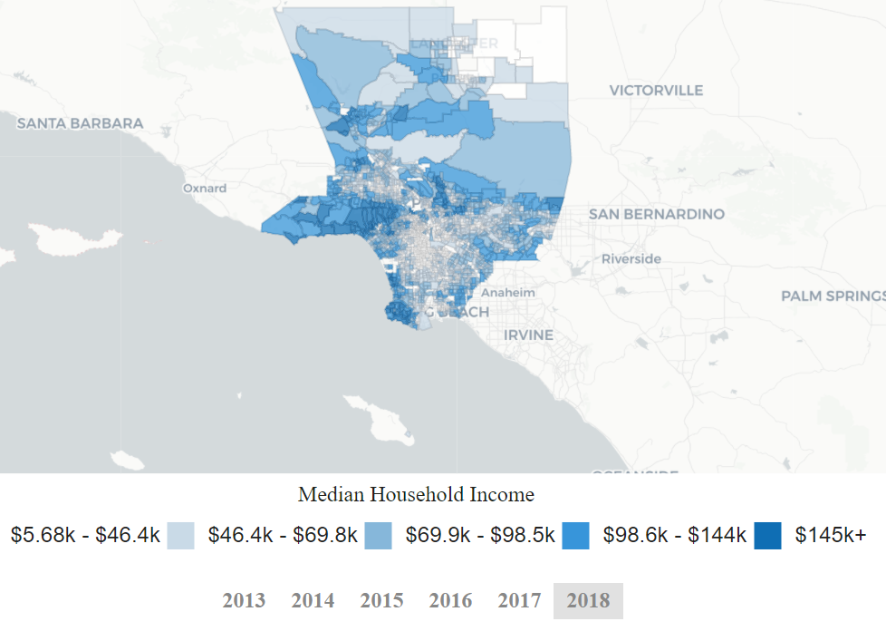
Wealth and Income disparity
In 2018, Los Angeles, CA had a population of 3.99M people with a median age of 35.8 and a median household income of $62,474. Between 2017 and 2018 the population of Los Angeles, CA declined from 4M to 3.99M, a -0.232% decrease and its median household income grew from $60,197 to $62,474, a 3.78% increase.
The picture belows shows the median household income in each district.

Slide 19
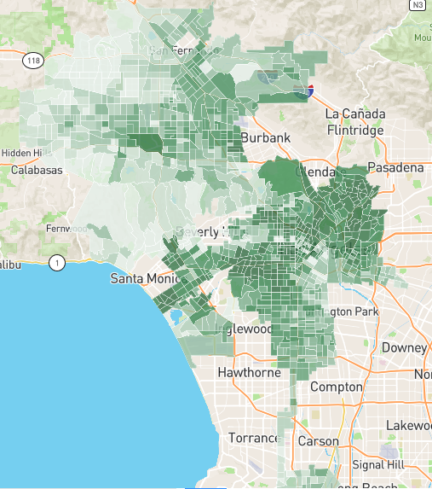
Real Estate - property value
With 3,979,576 people, 1,383,869 houses or apartments, and a median cost of homes of $705,221, real estate costs in Los Angeles are among some of the highest in the nation, although house prices here don't compare to real estate prices in the most expensive California communities. Large apartment complexes or high rise apartments are the single most common housing type in Los Angeles, accounting for 46.78% of the city's housing units. Other types of housing that are prevalent in Los Angeles include single-family detached homes ( 37.85%), duplexes, homes converted to apartments or other small apartment buildings ( 8.86%), and a few row houses and other attached homes ( 5.81%).
Cities with mostly row houses, apartments, and other high density housing types are relatively uncommon, and characteristic of compact cities that frequently have a downtown or other neighborhoods where amenities are within walking distance and a lot of street life can be seen.

Slide 20
Tourism -
visitors
Nearly all L.A. first-time visitors will want to visit Hollywood, Universal City (specifically Universal Studios), and Venice Beach as their top priorities within the City of Los Angeles itself. Century City, Downtown Los Angeles, UCLA, USC, Griffith Park and the Los Angeles River bridges just east of downtown are all also worth a look. They have all been used for filming a huge number of famous movies, television shows, and television commercials, and will seem slightly familiar for that reason.
Year | Total Visitors (millions) | Domestic Visitors | International Visitors | Total Visitor Spending Billions(US$)
2014 | 40.1 | 32.6 | 7.5 | 36.4
2015 | 44.3 | 36.1 | 8.2 | 37.2
2016 | 46.9 | 37.9 | 9.0 | 37.9
2017 | 48.5 | 40.1 | 9.6 | 38.5
2018 | 50.0 | 39.5 | 10.5 | 39.1

Slide 21
Discussion
New York City VS Los Angeles

Slide 22
Discussion
To determine the right property other tools can also be used, like checking the financial aspects to predict and calculate the value if it drops or rises. Besides that next to rentals, there is also a probability that you can buy the property and sell it afterwards. The most common way real estate offers a profit: It appreciates—that is, it increases in value. This is achieved in different ways for different types of property, but it is only realized in one way: through selling. However, you can increase your return on investment on a property in several ways. One way—if you borrowed money to buy the property—is to refinance the loan at lower interest. This will lower your cost basis for the property, thus increasing the amount you clear from it. Another probability is depending on your rights to the land, companies may pay you royalties for any discoveries or regular payments for any structures they add. These include, for example, pump jacks, pipelines, gravel pits, access roads, and cell towers. Raw land can also be rented for production, usually agricultural production, and land tracts with trees may be valuable for the timber that can be periodically harvested. Also there are some key takeaways as recommendations that have an influence on the property and for further research.

Slide 23
Take Aways
The most common way to make money in real estate is through appreciation—an increase in the property's value that is realized when you sell.
Location, development, and improvements are the primary ways that residential and commercial real estate can appreciate in value.
Inflation can also play a role in increasing a property's value over time.You can also make money in the form of income from rents for both residential and commercial properties, and companies may pay you royalties on raw land, for example, for any discoveries, such as minerals or oil.
Real estate investment trusts (REITs), mortgage-backed securities (MBSs), mortgage investment corporations (MICs), and real estate investment groups (REIGs) are investment alternatives within the real estate sector.
Important to keep in mind and look around in different perspective

Slide 24
Conclusion
New York City VS Los Angeles

Slide 25
Los Angeles
Population 10.1M
Median Age 36.7
The Number of Employees 5M
POVERTY RATE 16%
Median property value $625.200
Median Household Income $68.093

Slide 26
New York City
Population 8.4M
Median Age 36.9
The Number of Employees 4.09M
POVERTY RATE 18.9%
Median property value $645.100
Median Household Income $63.799

Slide 27
Investment will be
made in Los Angeles
The visitors of NYC are higher and will increase the potential opportunity to rent out the property. But it is not equal to receiving a higher profit and the costs. The property value of NYC is higher. In LA is a bit lower, then the purchase costs will be lower. The poverty rate in NYC is higher than LA and the median household income in LA is higher than NYC, which is positive. Taking the numbers in consideration the property investment will be made in Los Angeles. If you check all the results above, the numbers of LA are positive compared with NYC.

Slide 28
"SEIZE THE MOMENT, BECAUSE SOME OPPORTUNITIES DON’T COME TWICE"

Slide 29

Thank You!
Ronald Chen
IBM Data Science

